Slide 1
Comprehensive Digital Marketing Project Work

Slide 2

Part 1: Brand study, Competitor Analysis & Buyer’s/Audience’s Persona
COMPANY/TOPIC FOR PROJECT : HALDIRAMS
Research Brand Identity: Study the brand's mission, values, vision, and unique selling propositions (USPs).
Brand Colours :
Red, Yellow
Logo:
Mission/Values:
Mission : Review, recreate and rediscover the trend of healthy eating and innovate and invent fresh new methods to nourish and delight everyone we serve.
Vision :Achieve continuous and sustainable growth in the business, within India and abroad, organically and inorganically
USP:
Wide range of hygienic, tasty and authentic Indian savories and sweet

Slide 3
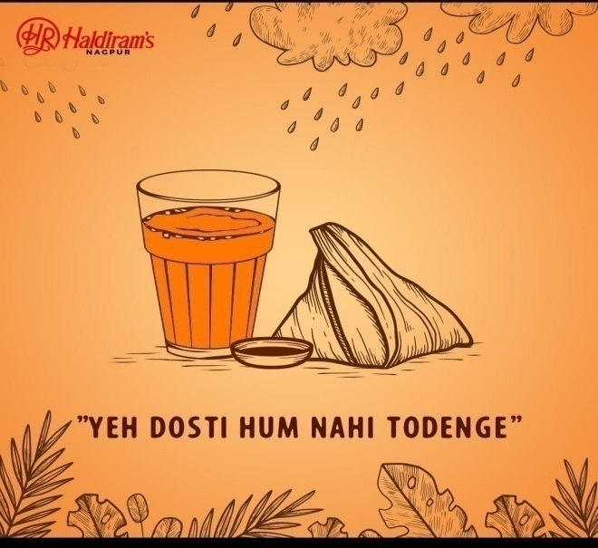
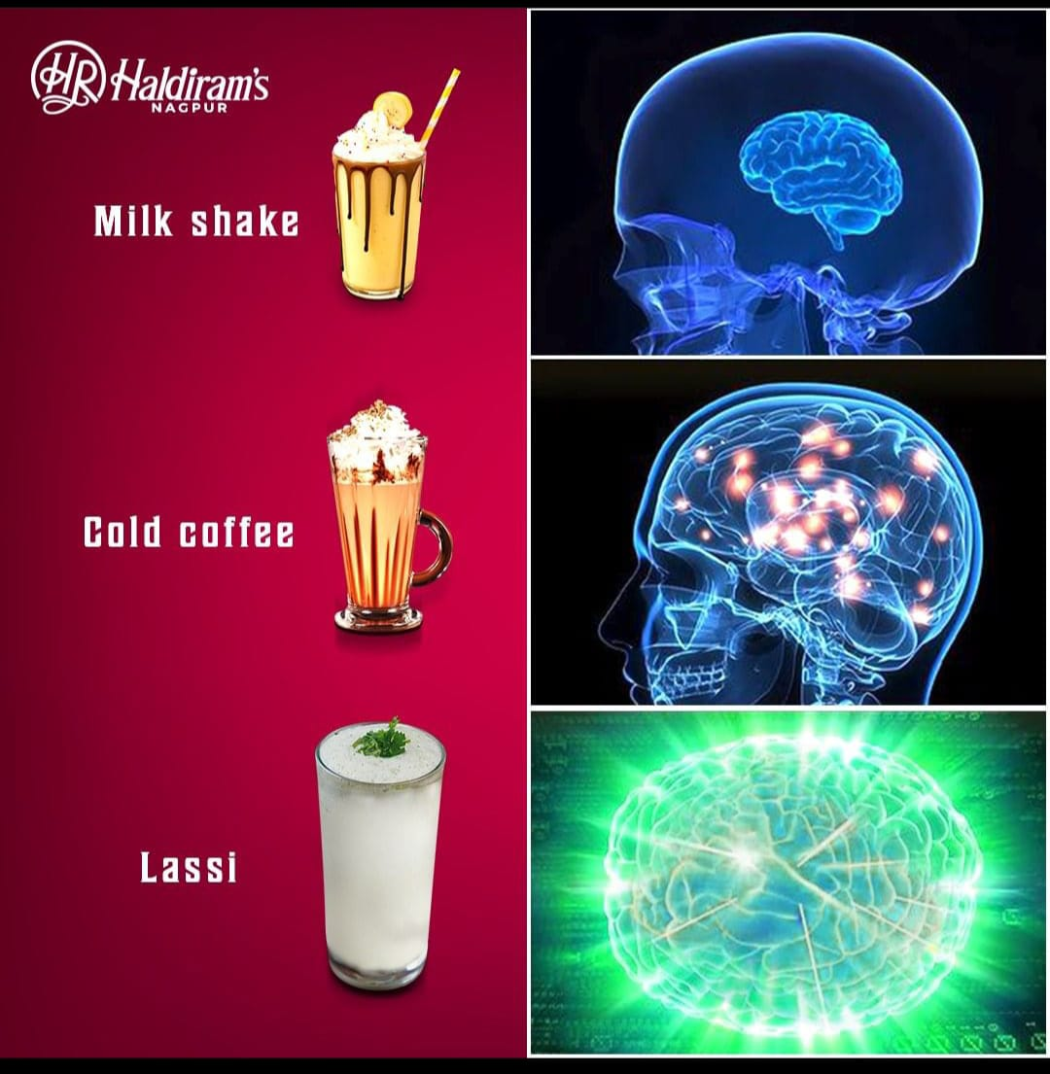
Part 1: Brand study, Competitor Analysis & Buyer’s/Audience’s Persona
COMPANY/TOPIC FOR PROJECT : HALDIRAMS
Analyze Brand Messaging:
Promoting through Funny Memes, user generated Content, Information through funny & Creative ideas
https://www.instagram.com/p/CuHdsV3xUx1/?igshid=MzRlODBiNWFlZA==
https://www.instagram.com/p/CtrHsq8PKrh/?igshid=MzRlODBiNWFlZA==
Examine the brand's tagline:
Delicious bhi Dooriyaan bhi

Slide 4
Part 1: Brand study, Competitor Analysis & Buyer’s/Audience’s Persona
Competitor Analysis: Select three competitors operating in the same industry or niche as the chosen brand, examine their USPs and online communication.
Competitor 1: BUNIYAA(Buy Indian Grocery Online of USA)
https://www.buniyaa.com/
USP:
I would need access to real-time information, which is beyond my capabilities
ONLINE COMMUNICATION:
Provided toll free number
Competitor 2: themintleaves
https://themintleaves.com/
USP:
The USP typically refers to the unique aspect or value proposition that sets a product, service, or brand apart from its competitors in the market.
ONLINE COMMUNICATION:
Perform an online search, Social media platforms, Company directories.

Slide 5
Competitor 3: fastindiangrocery
https://fastindiangrocery.us/
USP:
I recommend conducting an online search for their website or social media pages to learn more about their products, services, and what sets them apart from other grocery stores.
ONLINE COMMUNICATION:
Common communication channels for businesses include websites, Facebook, Twitter, Instagram, LinkedIn, and others.

Slide 6
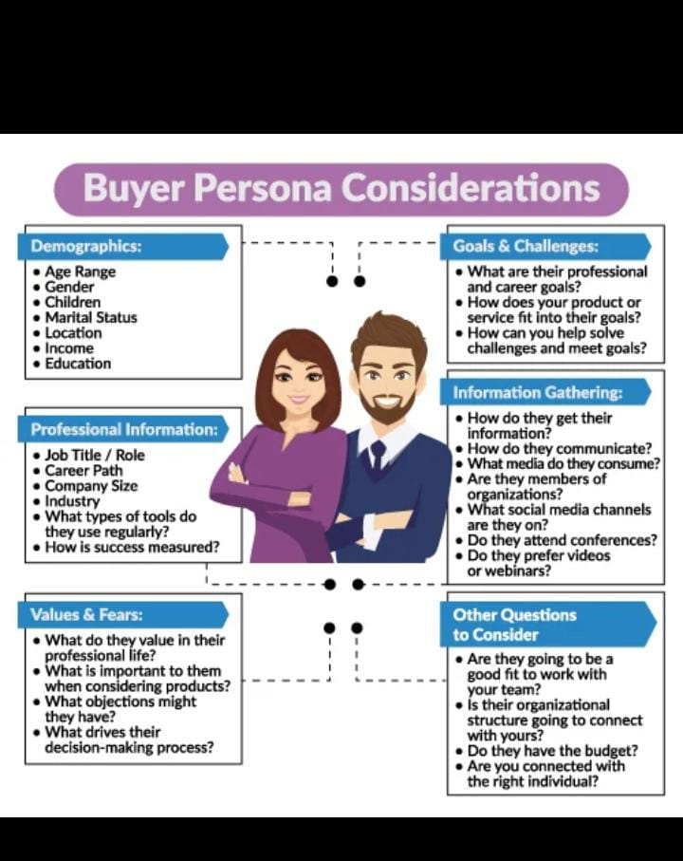
Part 1: Brand study, Competitor Analysis & Buyer’s/Audience’s Persona
Buyer's/Audience's Persona: Clearly define the target audience for the chosen brand. Consider demographics, psychographics, behaviors, and interests.
AGE RANGE: Above 3years
GENDER: Any Gender
CHILDERN: Yes
MARITAL STATUS: Married/Unmarried
LOCATION: Cities ,metro cities , towns ,villages Not in remoted villages But sometimes it may reach
INCOME: Over INR 500 cr
EDUCATION: Educated/Non Educated
WHAT DO THEY VALE IN THEIR PROFESSIONAL LIFE?- Quality, Customer Satisfaction, Brand Reputation, Hygiene and Food Safety.
WHAT IS IMPORTANT TO THEM WHEN CONSIDERING PRODUCTS?-Variety, Packaging, Affordability, Brand Trust, Suitability for Gifting.
WHAT OBJECTIONS MIGHT THEY HAVE?-Price Point, Lack of Healthy Snack Options, Consistency Issues.
HOW DO THEY GET THEIR INFORMATION?- Market Research, Customer Feedback, Sales Data and Analytics.
HOW DO THEY COMMUNICATE?-Sales Data and Analytics, Social Media, Customer Care and Helpline

Slide 7
Part 2: SEO & Keyword Research
SEO Audit: Do an SEO audit of the brands website
Keyword Research: Define Research Objectives, Brainstorm Seed Keywords, Utilize Keyword Research Tools (SEMrush or Moz Keyword Explorer),Analyze Competitor Keywords, Long-tail Keyword Exploration (specific, longer phrases) that align with the research objectives and have lower competition but higher conversion potential.
On page Optimization: Meta Tag optimization & content optimization
Reflect on the process of conducting keyword research and the SEO recommendations provided.
Document the challenges faced during the research and analysis phase, as well as the key insights gained from the keyword research process.

Slide 8
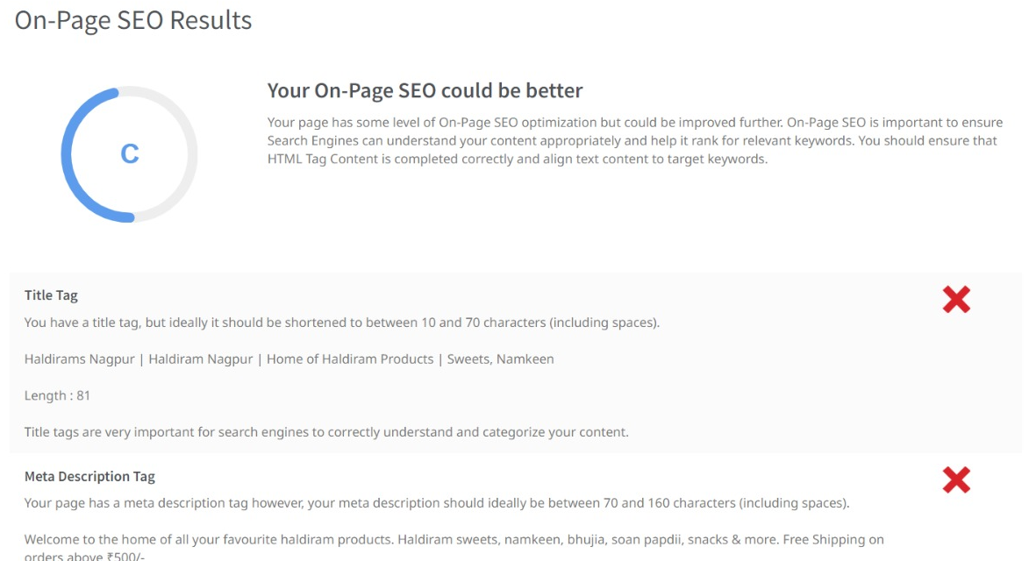
SEO Audit: Do an SEO audit of the brands website

Slide 9
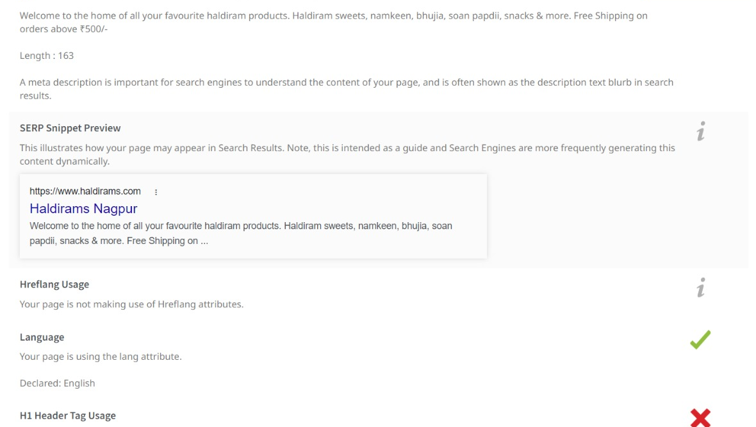

Slide 10
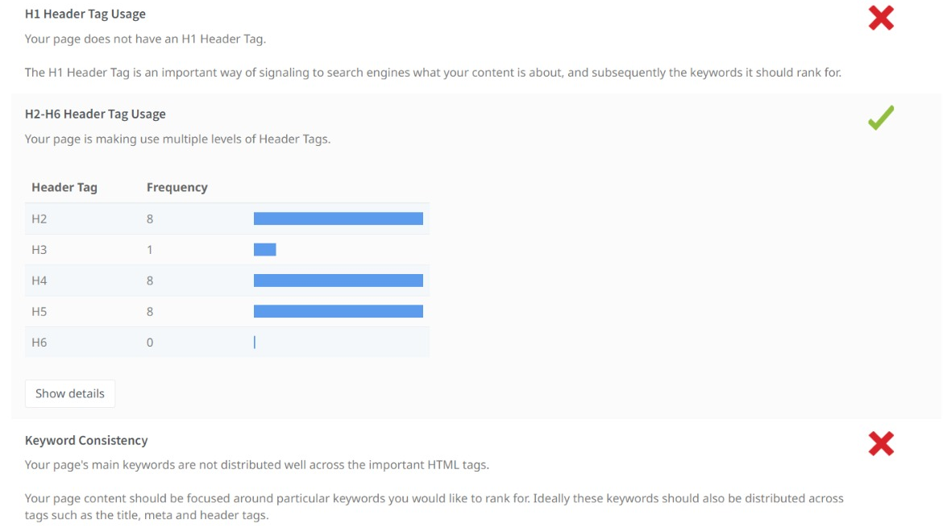

Slide 11
SWEETS
Keyword | Avg. monthly searches | Competition
kaju sweets | 5000 | High
baklava sweet | 50000 | High
papdi sweet | 500 | High
META TITLE
Explore Delicious kaju sweets , Baklava sweets , Papdi sweet |  |  | 56
META DESCRIPTION
Buy Tasty & Delicious kaju sweets , Baklava sweets , Papdi sweets at our Haldirams website |  |  | 86
CHIKKI
Keyword | Avg. monthly searches | Competition
peanut chikki | 5000 | High
crushed peanut chikki | 500 | High
peanut jaggery chikki | 500 | High
META TITLE
Explore peanut chikki , Crushed peanut chikki ,Peanut jaggery chikki |  |  | 66
META DESCRIPTION
Buy & Taste peanut chikki , Crushed peanut chikki& Peanut jaggery chikki at Haldirams |  |  |  | 84

Slide 12
BURFI
Keyword | Avg. monthly searches | Competition
orange burfi | 5000 | High
peanut burfi | 500 | High
groundnut burfi | 500 | High
META TITLE
Explore foods like Orange burfi, Peanut burfi & Groundnut burfi |  |  | 62
META DESCRIPTION
Buy & Taste our various items like Orange burfi, Peanut burfi & Groundnut burfi at Haldirams |  |  |  |  | 92
SOAN PAPDI
Keyword | Avg. monthly searches | Competition
chocolate soan papdi | 5000 | High
soan papdi mithai | 500 | High
rose soan papdi | 500 | High
META TITLE
Explore snacks like Chocolate, Rose soan papdi & Soan papdi mithai |  |  | 66
META DESCRIPTION
Pick up Various delicious snacks like Chocolate soan papdi, Rose Soan papdi & Soan papdi mithai at Haldirams |  |  |  |  |  | 108

Slide 13
CAKES
Keyword | Avg. monthly searches | Competition
milk cake | 50000 | Low
sweet cake | 5000 | Low
kaju cake | 500 | Low
META TITLE
Explore Tasty Milk cake , Sweet cake , Kaju cake at Haldirams |  | 57
META DESCRIPTION
Buy delicious Milk cake, Sweet cake, Kaju cake for Occations at Haldirams |  |  | 73

Slide 14
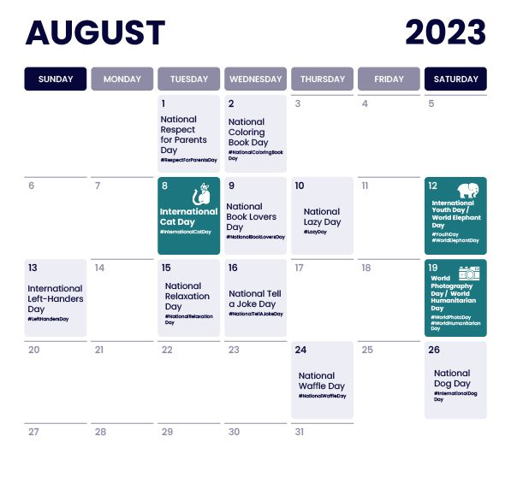
Part 3: Content Ideas and Marketing Strategies
Content Idea Generation & Strategy: Create a content calendar for the remaining month of July by brainstorming content themes, exploring various formats like blog posts, videos, infographics, podcasts, and interactive quizzes, and scheduling publication dates mainly on Facebook & Instagram.
And include the strategy, aim and the idea behind these posts and story
Content Calendar Example (Try creating a table for the month of July)

Slide 15
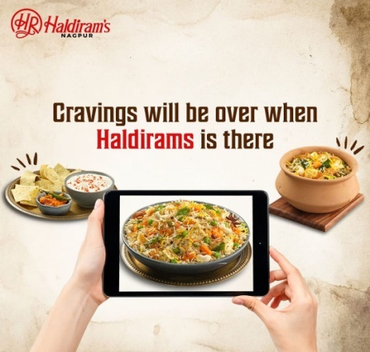
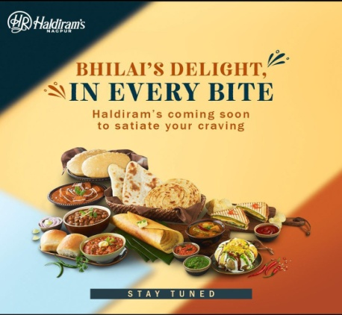
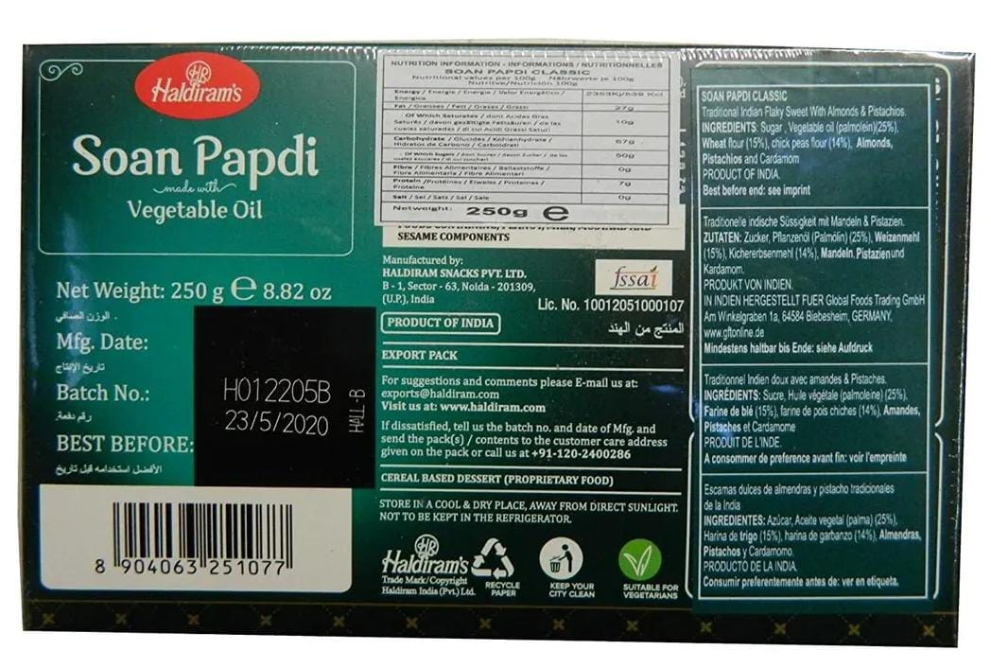
Part 3: Content Ideas and Marketing Strategies
Reflect on the content ideas and marketing strategies process, discussing the challenges encountered and lessons learned.
Date: 21/08/2023
Provide information about certain new products
I recommend visiting their official website or checking recent news and updates about their product launches
Date: 22/08/2023
To promote newly & fabulous products in Haldirams
Information about the different types of products on Haldirams
Date: 23/08/2023
To Awareness On Expiry Date
To create a Awareness poster on expiry date

Slide 16
Creating content ideas and devising effective marketing strategies is a dynamic process that involves continuous learning and adaptation. Throughout this journey, several challenges and valuable lessons can be encountered. 1.Understanding the Audience: One of the primary challenges is comprehending the target audience's preferences, needs, and pain points. 2. Generating Unique Ideas: Coming up with fresh and innovative content ideas can be difficult, especially in saturated markets. 3. Consistency and Quality: Maintaining a consistent flow of high-quality content can be demanding. Setting up an editorial calendar and adhering to a content creation schedule helps in maintaining quality and meeting deadlines. 4. Content Promotion: Even the best content may not gain traction without proper promotion. Crafting effective marketing strategies to reach the target audience across various channels is crucial for success. 5. Collaboration: Collaborating with influencers or other brands can amplify the reach of content and strengthen marketing efforts. The content ideas and marketing strategies process is an iterative and learning-oriented journey

Slide 17
Part 4: Content Creation and Curation (Post creations, Designs/Video Editing, Ad Campaigns over Social Media and Email Ideation and Creation)
Post Creation:
Select Content Categories: Identify three different content formats relevant to the chosen topic or industry. Research and Brainstorm: Research trending topics, industry news, or audience interests within each category. Brainstorm ideas for social media posts that align with each category. Do note that 1 content format has to be video and additionally 3 stories/status are to be created.
Format 1: Blog Article
Format 2: Video
Format 3: Creative

Slide 18
Part 4: Content Creation and Curation (Post creations, Designs/Video Editing, Ad Campaigns over Social Media and Email Ideation and Creation)
Format 1 : Blog Article
Aim: Provide information about certain new products
Date: 21/08/2023
Idea: I recommend visiting their official website or checking recent news and updates about their product launches.
Topic:
A Step by Step Guide To Information About Haldirams
Step 1: Visit Haldirams' Official Website : Go to the official website of Haldirams (www.haldirams.com) to access the most recent and official information about their products.
Step 2: Explore the Products Section : Look for a "Products" or "Product Catalog" section on Haldirams' website. This section should list their various product categories.
Step 3: Check for New Product Releases : Within the "Products" section, see if there is a subsection or page specifically dedicated to new product releases or updates. Companies often highlight their latest offerings on such pages.

Slide 19
Step 4: Read Press Releases and News Updates :Navigate to the "News" or "Press Releases" section of Haldirams' website. Here, you might find official announcements about new product launches.
Step 5: Follow Haldirams on Social Media : Follow Haldirams on social media platforms like Twitter, Facebook, Instagram, etc. Companies often share updates about their latest products and promotions on their social media accounts.
Step 6: Subscribe to Haldirams' Newsletter : Check if Haldirams offers a newsletter subscription option on their website. Subscribing to their newsletter can keep you informed about new products and offers.
Step 7: Look for Public Announcements : Keep an eye on general news sources, food industry publications, and local media outlets. They might cover new product launches by Haldirams.
Step 8: Visit Haldirams Stores : If you have a Haldirams store nearby, visit it to explore their product offerings. Sometimes, new products are introduced in physical stores before they are widely promoted online.

Slide 20

Part 4: Content Creation and Curation (Post creations, Designs/Video Editing, Ad Campaigns over Social Media and Email Ideation and Creation)
Format 2 : Video
Aim: To promote newly & fabulous products in Haldirams
Date: 22/08/2023
Idea: Information about the different types of products on Haldirams
Topic:
This video visualised about different types of products on Haldirams

Slide 21
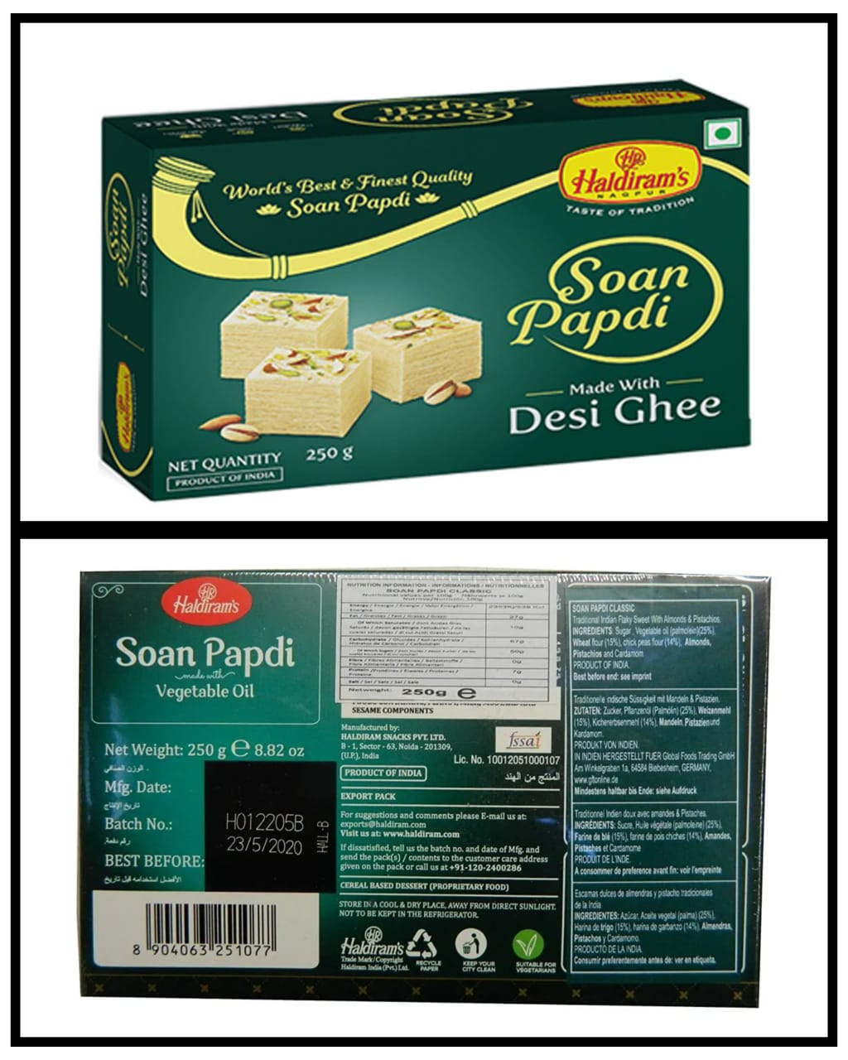
Part 4: Content Creation and Curation (Post creations, Designs/Video Editing, Ad Campaigns over Social Media and Email Ideation and Creation)
Format 3 : Creative
Aim: To Awareness On Expiry Date
Date: 23/08/2023
Idea: To create a Awareness poster on expiry date
Topic: Informative
Poster

Slide 22
Part 4: Content Creation and Curation (Post creations, Designs/Video Editing, Ad Campaigns over Social Media and Email Ideation and Creation)
Instagram Story
Utilize the Stories feature on Instagram for three consecutive days. Share behind-the-scenes glimpses, polls, quizzes, or sneak peeks etc to encourage audience participation. Once uploaded use the story highlight feature on Instagram and save the 3 story with an appropriate name for each.
Note:
Once done monitor the performance of the posts and Stories using the insight tool and analyze the engagement metrics (likes, comments, shares, impressions, etc.). Based on the analysis, mention the strategies and areas for improvement.

Slide 23
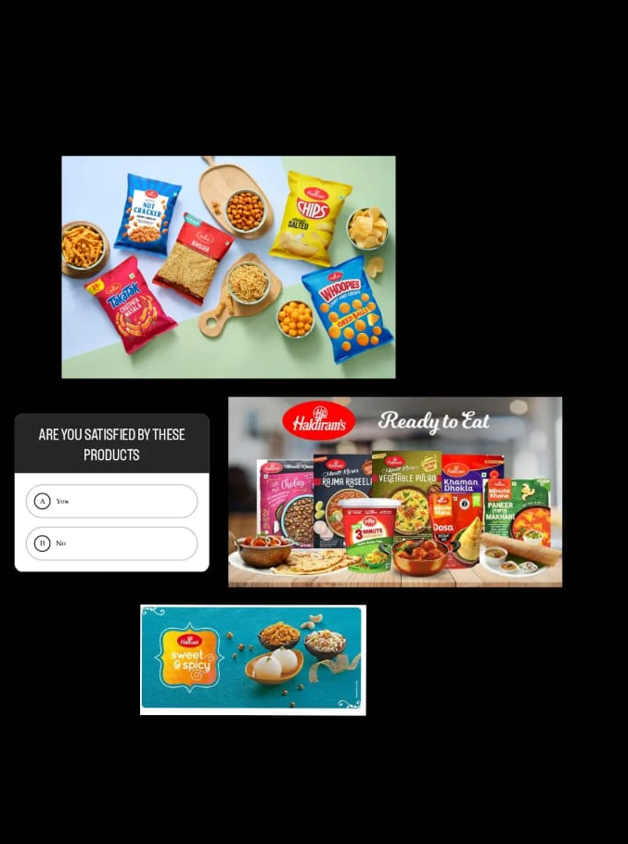
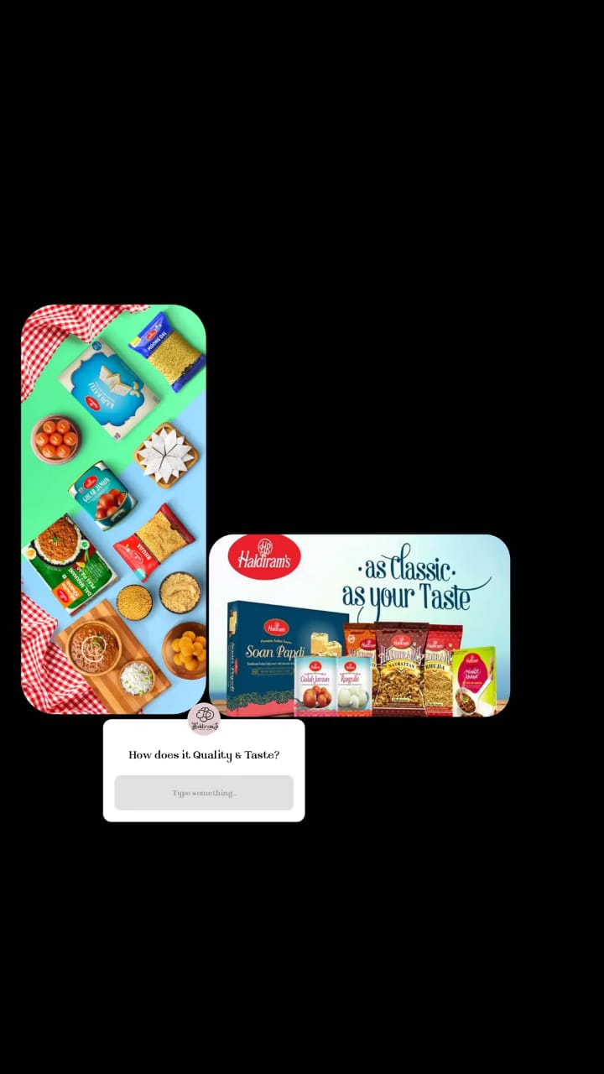
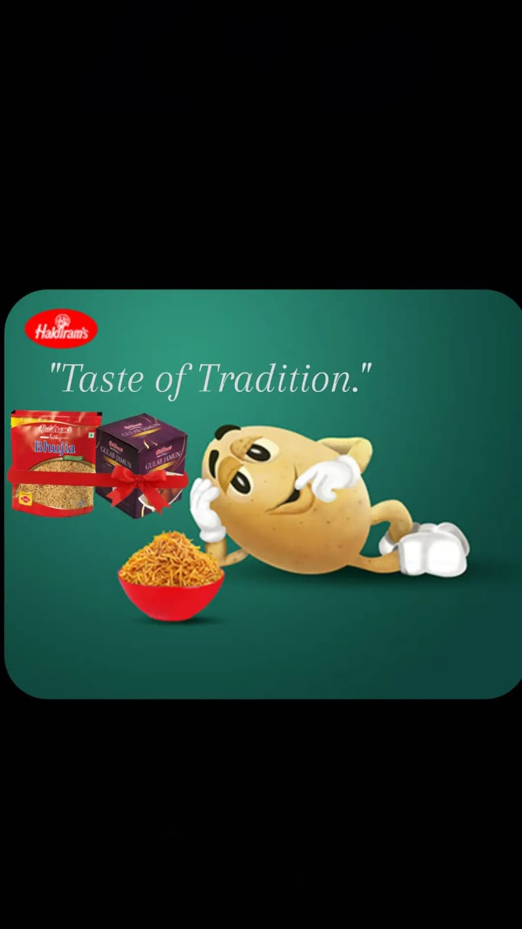
Part 4: Content Creation and Curation (Post creations, Designs/Video Editing, Ad Campaigns over Social
Media and Email Ideation and Creation)
Instagram Story

Slide 24
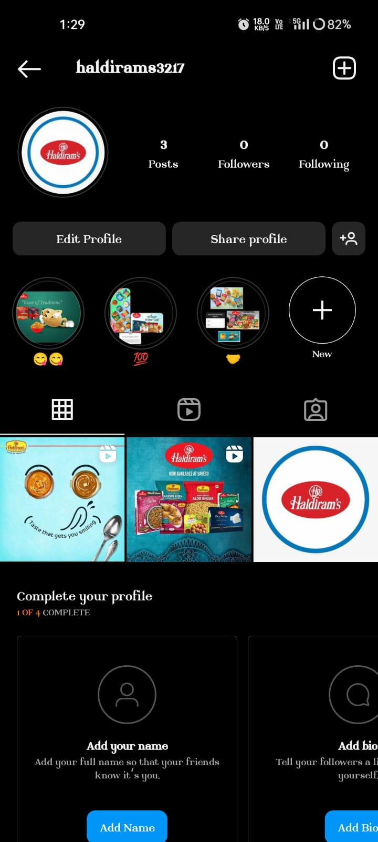

Slide 25
Part 4: Content Creation and Curation (Post creations, Designs/Video Editing, Ad Campaigns over Social Media and Email Ideation and Creation)
Designs/Video Editing
Design Tools Familiarization (use Canva for creating visually appealing graphics)
Video Creation: Utilize VN or any video editor of your choice to create videos related to the chosen topic.

Slide 26
Part 4: Content Creation and Curation (Post creations, Designs/Video Editing, Ad Campaigns over Social Media and Email Ideation and Creation)
Social Media Ad Campaigns
Ad Campaigns over Social Media:
Come up with 3 ad campaigns each covering one of the mentioned goals: brand awareness, driving website traffic, or generating leads

Slide 27
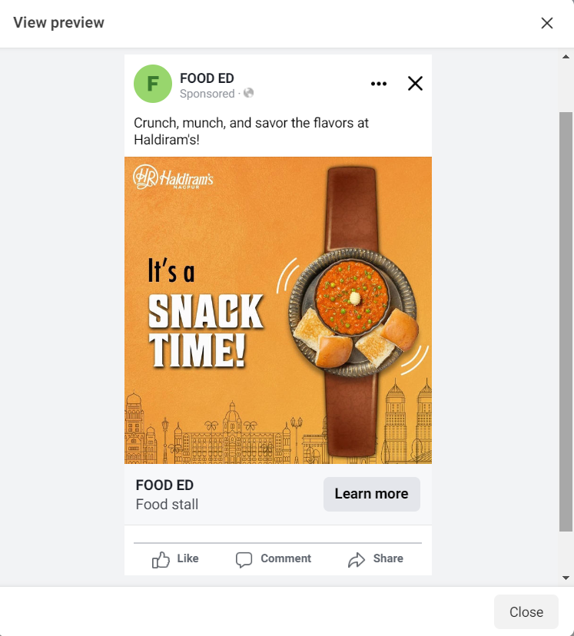
Brand awareness:
Targeting- Location: India, All Genders
Interests: Bajaj Sweets, Sairams Sweets.

Slide 28
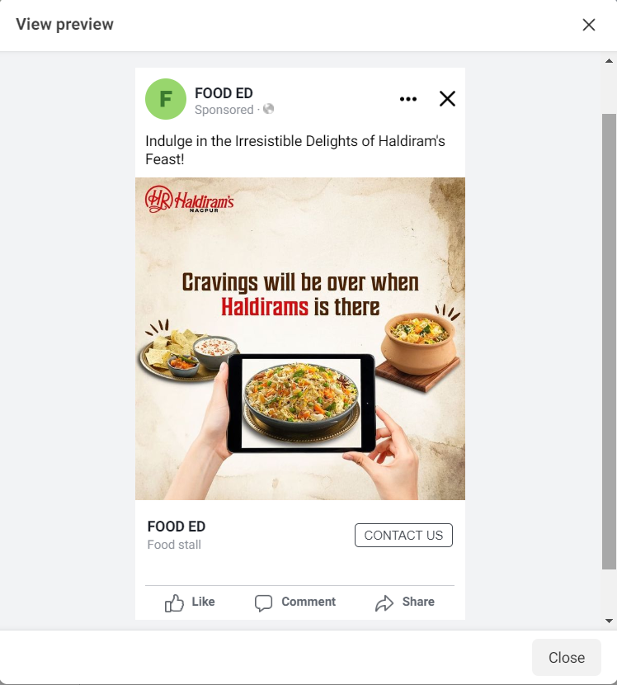
Driving website traffic :
Targeting- Location: India, All Genders
Interests: Bajaj Sweets, Sairams Sweets.

Slide 29
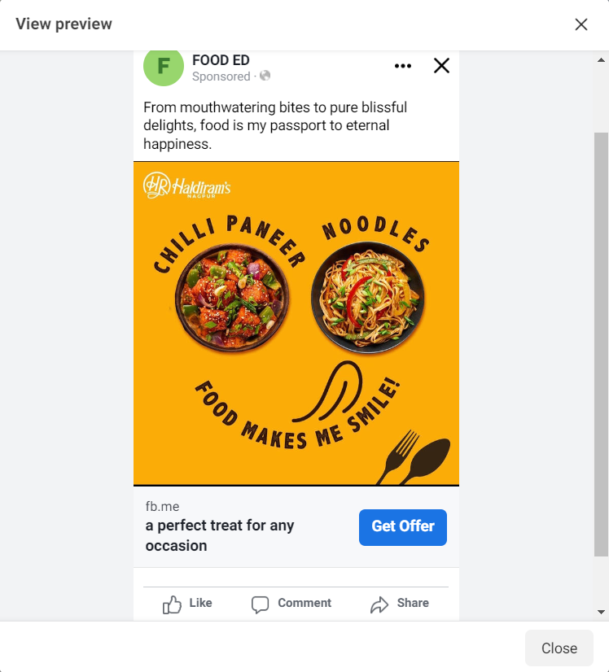
Generating leads :
Targeting- Location: India, All Genders
Interests: Bajaj Sweets, Sairams Sweets.

Slide 30
Part 4: Content Creation and Curation (Post creations, Designs/Video Editing, Ad Campaigns over Social Media and Email Ideation and Creation)
For every campaign clearly define:
Advertising Goals: increasing brand awareness, driving website traffic, or generating leads.
Audience Targeting: Define the target audience for the ad campaigns based on demographics, interests, and behavior.
Ad Creation: Create visually appealing ad creatives, compelling ad copy and relevant call-to-action.

Slide 31
Part 4: Content Creation and Curation (Post creations, Designs/Video Editing, Ad Campaigns over Social Media and Email Ideation and Creation)
Email Ad Campaigns
Ad Campaigns for email marketing:
Come up with 2 email ad campaigns with the mentioned goals: brand awareness & generating leads

Slide 32
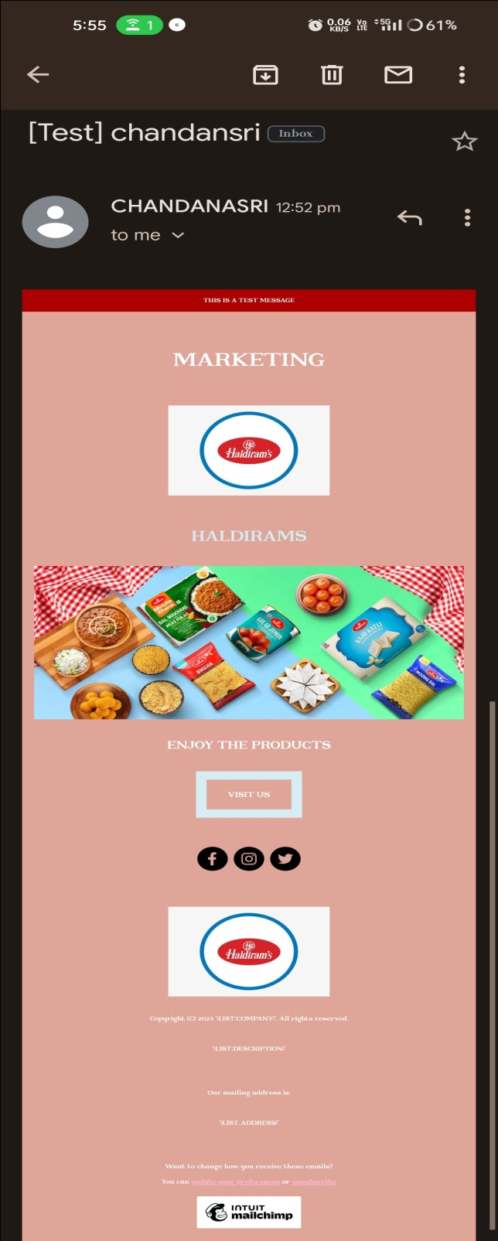
Email Ad Campaign 1 - Brand Awareness
(insert emailer image)

Slide 33
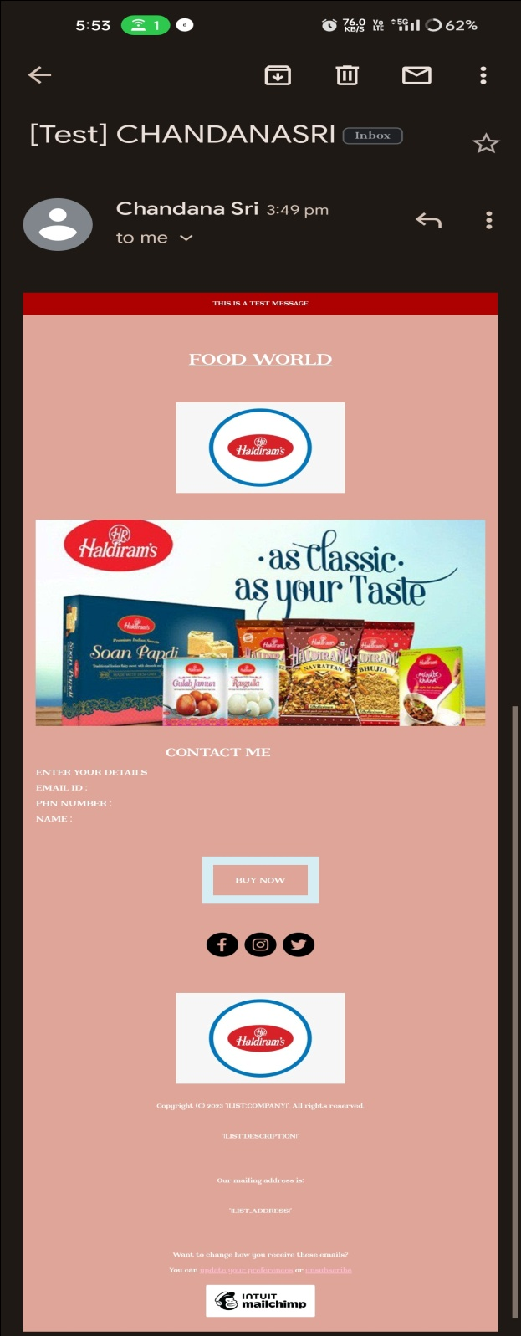
Email Ad Campaign 2 - Lead Generation
(insert emailer image)

Slide 34
Part 4: Content Creation and Curation (Post creations, Designs/Video Editing, Ad Campaigns over Social Media and Email Ideation and Creation)
Reflect on the content creation and curation process, discussing the challenges faced and lessons learned.
1. Consistency is Key: Maintaining a consistent tone, style, and frequency of content across platforms helps reinforce brand identity and improves audience recall.
2.Visual Appeal: Eye-catching visuals, well-designed graphics, and professionally edited videos can significantly enhance the impact of content and ad campaigns.
3. A/B Testing: Regularly conducting A/B + tests for ad campaigns and email subject lines allows for data-driven optimization and better results.
4.Know our Audience: Understanding the target audience's interests, pain points, and preferences is fundamental in creating relevant and engaging content.
5. Engage with the Audience: Responding to comments, messages, and feedback from the audience fosters a sense of community and builds trust.
6. Long-Term Approach: Content creation and marketing are not one-time endeavors. A long-term, strategic approach is necessary to build brand awareness and achieve sustainable growth.
In conclusion, content creation and curation, along with thoughtful design, video editing, and well-executed ad campaigns, play a pivotal role in a successful marketing strategy. By understanding the challenges and incorporating the lessons learned, businesses can create compelling content that resonates with their target audience and drives results

